Slide 1

Ansible
Hands on Training

Slide 2
Agenda
Fundamentals
Key Components
Best practices
Spring Boot REST API Deployment
CI with Ansible
Ansible for AWS
Provisioning a Docker Host
Docker&Ansible

Slide 3

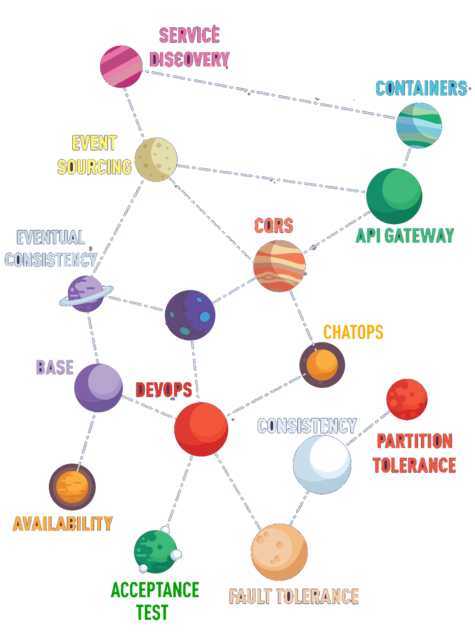
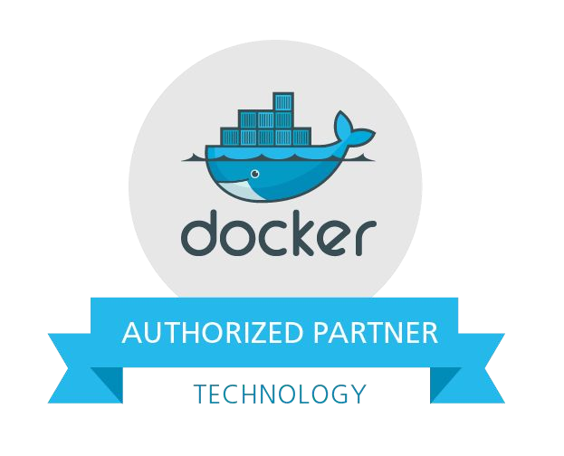









DevOps & MicroServices Consultancy
We consult you move towards Containerization, Automated Provisioning, Deployment/Release Automation, Test Automation, Performance Tuning and moving to Cloud…
@kloia_com
kloia.com
kloia.co.uk
blog.kloia.com

Slide 4
Fundamentals

Slide 5
Fundamentals
What is Ansible?
Why Ansible?
Terms
Inventory
Host
Group
Playbook
Play
Task
Modules
Library

Slide 6
What is Ansible?
Radically simple IT automation engine that automates
Cloud provisioning
Configuration management
Application deployment
Intra-service orchestration

Slide 7
Why Ansible?
Simple
Easy to write, read, maintain and evolve- without writing scripts or custom code
Fast to learn and setup
It uses a very simple language (YAML, in the form of Ansible Playbooks) that allow you to describe your automation jobs in a way that approaches plain English.

Slide 8
Why Ansible?
Efficient
Doesn't require a custom agent or software to install
Ansible works by connecting to your nodes and pushing out small programs, called "Ansible modules" to them.
Secure
No agent
Runs on OpenSSH

Slide 9
Inventory
Ansible works against multiple systems in your infrastructure at the same time. It does this by selecting portions of systems listed in Ansible’s inventory file, which defaults to being saved in the location /etc/ansible/hosts.
[webservers] | [appservers] | [dbservers]
192.168.35.140 | 192.168.100.1 | 172.35.0.5
192.168.35.141 | 192.168.100.2
192.168.35.142 | 192.168.100.3
192.168.35.143

Slide 10
Host
A host is simply a remote machine that Ansible manages. They can have individual variables assigned to them, and can also be organized in groups.
[webservers]
192.168.35.140
192.168.35.141
192.168.35.142
192.168.35.143
[appservers]
192.168.100.1
192.168.100.2
192.168.100.3
[dbservers]
172.35.0.5

Slide 11
Group
A group consists of several hosts assigned to a pool that can be conveniently targeted together, and also given variables that they share in common.
[webservers] | [appservers] | [dbservers]
192.168.35.140 | 192.168.100.1 | 172.35.0.5
192.168.35.141 | 192.168.100.2
192.168.35.142 | 192.168.100.3
192.168.35.143

Slide 12
Playbook
Playbooks are the language by which Ansible orchestrates, configures, administers, or deploys systems. Playbooks contain Plays.
Install application server and database server
Install & Start Apache Tomcat
Install Java Install Tomcat
Install & Start MySQL & Import Data
Install MySQL Import Data

Slide 13
Play
A play is a mapping between a set of hosts selected by a host specifier and the tasks which run on those hosts to define the role that those systems will perform.
Install application server and database server
Install & Start Apache Tomcat
Install Java Install Tomcat
Install & Start MySQL & Import Data
Install MySQL Import Data

Slide 14
Task
Tasks combine an action with a name and optionally some other keywords (like looping directives). Tasks call modules .
Install application server and database server
Install & Start Apache Tomcat
Install Java Install Tomcat
Install & Start MySQL & Import Data
Install MySQL Import Data

Slide 15
Module
Modules are the units of work that Ansible ships out to remote machines. Ansible refers to the collection of available modules as a library.
Install Java
Download Oracle JDK
get_url:
Install Oracle JDK
yum:
name:
jdk-1.8.0-linux-x64.rpm state: present
url:http://download.oracle.com dest:jdk-1.8.0-linux-x64.rpm

Slide 16

Library
A collection of modules made available to /usr/bin/ansible or an Ansible playbook.

Slide 17
Install Ansible
Latest Release via Yum
# install the epel-release RPM if needed on CentOS, RHEL, or Scientific Linux
$ sudo yum install ansible
Latest Release via Apt
$ | sudo | apt-get install software-properties-common
$ | sudo | apt-add-repository ppa:ansible/ansible
$ | sudo | apt-get update
$ | sudo | apt-get install ansible

Slide 18
Install Ansible
Latest Release via Pip
$ sudo easy_install pip
$ sudo pip install ansible

Slide 19
Control Machine System Requirements
Currently Ansible can be run from any machine with Python 2.6 or 2.7 installed (Windows isn’t supported for the control machine).

Slide 20
Node Machine System Requirements
On the managed nodes, you need a way to communicate, which is normally ssh. By default this uses sftp. If that’s not available, you can switch to scp in ansible.cfg.
You also need Python 2.4 or later. If you are running less than
Python 2.5 on the remotes, you will also need:
python-simplejson

Slide 21
LAB #1
Install Ansible

Slide 22

Install Ansible
Let’s start with cloning the repository we will walk during the trainig
$ git clone https://github.com/maaydin/ansible-tutorial.git
$ cd ansible-tutorial
Provision the Control Machine and install ansible
$ vagrant up
$ vagrant ssh control
$ sudo apt-get install software-properties-common
$ sudo apt-add-repository ppa:ansible/ansible
$ sudo apt-get update
$ sudo apt-get install ansible

Slide 23
Validate Ansible Installation
Check the ansible version
$ ansible --version
ansible 2.2.0.0
config file = /etc/ansible/ansible.cfg
configured module search path = Default w/o overrides

Slide 24
Ad-Hoc Commands on Local Machine
Ping the localhost
$ ansible -m ping localhost
[WARNING]: provided hosts list is empty, only localhost is available
localhost | SUCCESS => { "changed": false, "ping": "pong"
}

Slide 25
Key Components

Slide 26
Inventory

Slide 27
Inventory Concepts
Hosts & Groups
Host & Group Variables
Groups of Groups
Inventory Parameters
Dynamic Inventory

Slide 28
Hosts & Groups
The format for /etc/ansible/hosts is an INI-like format and looks
like this:
mail.example.com
[webservers] foo.example.com bar.example.com
[dbservers] one.example.com two.example.com three.example.com

Slide 29
Hosts & Groups
Different SSH port:
web1:2222
Using aliases:
web2 ansible_port=22 ansible_host=192.168.35.102
Ranges:
[webservers]
www[01:50].example.com

Slide 30
Host & Group Variables
Assign variables to hosts that will be used later in playbooks
[webservers]
web1 http_port=80 https_port=443 web2 http_port=8080 https_port=8443
Variables can also be applied to an entire group at once
[webservers:vars]
ntp_server=tr.pool.ntp.org proxy=proxy.example.com

Slide 31
Groups of Groups
To make groups of groups use the :children suffix.
[euwest] host1
[eucentral] host2
[eu:children] euwest eucentral

Slide 32
Inventory Parameters
ansible_user
The default ssh user name to use.
ansible_ssh_private_key_file
Private key file used by ssh. Useful if using multiple keys and you don’t want to use SSH agent.
ansible_become
Equivalent to ansible_sudo or ansible_su, allows to force privilege escalation

Slide 33
Dynamic Inventory
Inventory can also be gathered on demand from other sources dynamically. Those sources include:
Cobbler ( http://cobbler.github.io/ )
Cloud APIs
Rackspace
Amazon
Digital Ocean
OpenStack

Slide 34
LAB #2
Create the Inventory

Slide 35
Create the Hosts in the Inventory
Create the Ansible Inventory for given hosts:
web1 192.168.35.101
web2 192.168.35.102
app 192.168.35.103
db 192.168.35.104

Slide 36
Create the Groups in the Inventory
Create the Inventory for given groups consist of below servers & groups
webservers: web1 & web2
appservers: app dbservers: db
dc: webservers & appservers & dbservers

Slide 37
Inventory
web1 ansible_host=192.168.35.101 web2 ansible_host=192.168.35.102 app ansible_host=192.168.35.103 db ansible_host=192.168.35.104
[webservers] web1
web2
[appservers] app
[dbservers] db
[dc:children] webservers appservers dbservers

Slide 38
Ad-Hoc Commands on Inventory
Ping the hosts and groups you defined
$ | ansible | -m | ping | web1
$ | ansible | -m | ping | app
$ | ansible | -m | ping | webservers
$ | ansible | -m | ping | dc

Slide 39
Tip #1: SSH Keys
To set up SSH agent to avoid retyping passwords, you can add the private key
$ vagrant ssh control
$ ssh-agent bash
$ ssh-add /vagrant/keys/key
Creating a New SSH Key Pair
$ ssh-keygen

Slide 40
Tip #2: Host Key Checking
If you wish to disable host key checking, you can do so by editing
/etc/ansible/ansible.cfg or ~/.ansible.cfg:
[defaults]
host_key_checking = False
Alternatively this can be set by an environment variable:
$ export ANSIBLE_HOST_KEY_CHECKING=False

Slide 41
Ad-Hoc Commands on Inventory
Run some shell commands on the hosts and groups you defined
$ | ansible | -m | shell | -a | 'ls -al' web1
$ | ansible | -m | shell | -a | 'whoami' app
$ | ansible | -m | shell | -a | 'ifconfig' webservers
$ | ansible | -m | shell | -a | 'hostname' dc

Slide 42
Tip #3: Patterns
A pattern usually refers to a set of groups (which are sets of hosts)
$ | ansible | -m | ping | all
$ | ansible | -m | ping | web*
$ | ansible | -m | ping | 'appservers:dbservers'
$ | ansible | -m | ping | 'dc:!webservers'
$ | ansible | -m | ping | 'dc:&webservers'

Slide 43
Tasks

Slide 44
Tasks
A task is a discrete action that is a declaration about the state of a system.
Example Tasks:
Directory should exist
Package should be installed
Service should be running
Cloud Instance should exist

Slide 45
Tasks as Ad-Hoc Commands
Ansible can execute single tasks on sets of hosts to full-fill an ad-hoc declarations.
$ ansible webservers -m file -a "path=/var/www/html/assets state=directory"
$ ansible webservers -m apt -a "name=nginx state=present"
$ ansible webservers -m service -a "name=nginx enabled=yes state=started"

Slide 46
Modules

Slide 47
Modules
Modules are the bits of code copied to the target system to be executed to satisfy the task declaration.
Code need not exist on remote host -- ansible copies it over
Many modules come with Ansible -- "batteries included"
Custom modules can be developed easily
Command/shell modules exists for simple commands
Script module exists for using existing code
Raw module exists for executing raw commands over ssh

Slide 48
Modules Documentation
Module listing and documentation via ansible-doc
$ ansible-doc -l
$ ansible-doc apt
Module index
http://docs.ansible.com/ansible/modules_by_category.html

Slide 49
LAB #3
Using Common Modules

Slide 50
Install Nginx with Ad-Hoc Commands
Install the nginx server on webservers with apt module
$ ansible -m apt -a "name=nginx state=present update_cache=yes" web1

Slide 51
Tip #4: Become (Privilege Escalation)
Ansible can use existing privilege escalation systems to allow a user to execute tasks as another.
Ansible allows you to ‘become’ another user, different from the user that logged into the machine (remote user). This is done using existing privilege escalation tools, which you probably already use or have configured, like sudo, su, pfexec, doas, pbrun, dzdo, ksu and others.
$ ansible -m shell -a "whoami" web1 --become

Slide 52
Install Nginx with Ad-Hoc Commands
Install the nginx server on webservers with apt module
$ ansible -m apt -a "name=nginx state=present update_cache=yes" web1 --become
Ensure service enabled and started on webservers with service module
$ ansible -m service -a "name=nginx state=started enabled=yes" webservers
--become

Slide 53
Install Nginx with Ad-Hoc Commands
Ensure /usr/share/nginx/html directory exists on webservers with file module
$ ansible -m file -a "path=/usr/share/nginx/html state=directory" webservers
--become
Update /usr/share/nginx/html/index.html file a custom file with copy module
$ ansible -m copy -a "src=index.html dest=/usr/share/nginx/html/index.html"
webservers --become

Slide 54
Modules Exercises
Ensure default-jdk package installed on appservers.
Ensure greeting user created on appservers.
Ensure /var/log/greeting directory owned by greeting user created on appservers.
Ensure mongodb-server package installed on dbservers.

Slide 55
Plays

Slide 56
Plays
Plays are ordered sets of tasks to execute against host selections from your inventory.
Install application server and database server
Install & Start Apache Tomcat
Install Java Install Tomcat
Install & Start MySQL & Import Data
Install MySQL Import Data

Slide 57
Plays
---
- name: Nginx Play
Host Selection
Privilege Escalation
Naming
Variables
hosts: webservers
vars:
assets_dir: /var/www/html/static become: true
tasks:
Tasks
name: ensure nginx is installed apt: name=nginx state=present
name: ensure directory exists
file: path={{ assets_dir }} state=directory

Slide 58
Conditionals
tasks:
command: /bin/false register: result ignore_errors: True
command: /bin/something when: result|failed
command: /bin/something_else when: result|succeeded
command: /bin/still/something_else when: result|skipped

Slide 59
Loops
tasks:
command: /bin/false register: result ignore_errors: True
command: /bin/something when: result|failed
command: /bin/something_else when: result|succeeded
command: /bin/still/something_else when: result|skipped

Slide 60
Handlers
tasks:
name: Update nginx default config
copy: src=default.conf dest=/etc/nginx/sites-enabled/default notify:
Test nginx configuration
Reload nginx configuration
handlers:
name: Test nginx configuration command: nginx -t
name: Reload nginx configuration command: nginx -s reload

Slide 61
Playbooks

Slide 62
Playbooks
Playbooks are ordered sets of plays to execute against inventory selections.
Install application server and database server
Install & Start Apache Tomcat
Install Java Install Tomcat
Install & Start MySQL & Import Data
Install MySQL Import Data

Slide 63
Running Playbooks
To run a play book use ansible-playbook command.
$ ansible-playbook play.yml
Hosts can be changed by providing a inventory file
$ ansible-playbook -i production play.yml
Environment variables can be set globally
$ ansible-playbook -e "assets_dir=/var/www/html/assets/" play.yml

Slide 64
Running Playbooks
Hosts can be limited by providing a subset
$ ansible-playbook -i production play.yml
Number of parallel processes to use can be specified (default=5)
$ ansible-playbook -f 30 play.yml

Slide 65
LAB #4
Running Playbooks

Slide 66
Install Nginx with a Single Play
Install the nginx server on webservers
---
hosts: webservers become: true tasks:
name: Install nginx
apt: name=nginx state=present
name: Start nginx
service: name=nginx state=started enabled=yes

Slide 67
Install Nginx with a Single Play
$ ansible-playbook /vagrant/lab-04/install-nginx.yml -l web1
PLAY [webservers] **************************************************************
TASK [setup] ******************************************************************* ok: [web1]
TASK [Install nginx] *********************************************************** ok: [web1]
TASK [Start nginx] ************************************************************* ok: [web1]
PLAY RECAP ********************************************************************* web1 : ok=3 changed=0 unreachable=0 failed=0

Slide 68
Install Nginx & JDK & MongoDB in a Playbook
Install the nginx server on webservers
Install JDK on appservers
Install MongoDB on dbservers

Slide 69
Roles

Slide 70
Roles
Roles are portable units of task organization in playbooks and is the best way to organize your playbooks.
Roles are just automation around ‘include’ directives, and really don’t contain much additional magic beyond some improvements to search path handling for referenced files.
However, that can be a big thing!

Slide 71
Example Project Structure
site.yml webservers.yml fooservers.yml roles/
common/ files/ templates/ tasks/ handlers/ vars/ defaults/ meta/
webservers/ tasks/

Slide 72
Example Playbook
---
hosts: webservers roles:
common
webservers

Slide 73
Example Role
---
name: Install EPEL repo
yum: name=epel-release state=present
name: Install nginx server
yum: name=nginx enablerepo=epel state=present
name: Create static content directory
file: path=/usr/share/nginx/static state=directory

Slide 74
LAB #5
Running Playbooks with Roles

Slide 75
Install NTP & Nginx with in Roles
Install the ntp service & nginx server on webservers and deploy static content
---
hosts: webservers become: true roles:
ntp
nginx
deploy_static_content

Slide 76
Install Nginx & JDK & MongoDB with in Roles
Install ntp service on all servers
Install the nginx server on webservers
Deploy static content on webservers
Install JDK on appservers
Install MongoDB on dbservers

Slide 77
Best Practices

Slide 78
Complexity Kills
Strive for simplification
Optimize for readability
Think declaratively

Slide 79
Project Layout
├── config.yml
├── provision.yml
├── roles
│ ├── myapp
│ │
│ │
│ │
│ ├── nginx
│
│ └── etc.etc
│ └── proxy
├── tasks
│ └── main.yml
└── etc.etc
│ └── etc.etc
└── site.yml

Slide 80
Meaningful Inventory Names
10.1.2.75
10.1.5.45
10.1.4.5
10.1.0.40
db1 ansible_host=10.1.2.75 db2 ansible_host=10.1.5.45 db3 ansible_host=10.1.4.5 db4 ansible_host=10.1.0.40
w14301.acme.com w17802.acme.com W19203.acme.com w19304.acme.com
web1 ansible_host=w14301.acme.com web2 ansible_host=w17802.acme.com web3 ansible_host=w19203.acme.com web4 ansible_host=w19203.acme.com

Slide 81
Vertical Reading is Easier
- name: install telegraf
yum: name=telegraf-{{ telegraf_version
}} state=present update_cache=yes disable_gpg_check=yes enablerepo=telegraf
- name: install telegraf yum: YES
name: telegraf-{{ telegraf_version }} state: present
update_cache: yes disable_gpg_check: yes enablerepo: telegraf

Slide 82
Meaningful Task Names
hosts: web tasks:
yum:
name: httpd state: latest
service:
name: httpd state: started enabled: yes
hosts: web
name: installs and starts apache tasks:
name: install apache packages yum:
name: httpd state: latest
name: starts apache service service:
name: httpd state: started enabled: yes

Slide 83
Meaningful Task Names
PLAY [web]
*****************************************
TASK [setup]
***************************************** ok: [web1]
TASK [yum]
***************************************** ok: [web1]
TASK [service]
***************************************** ok: [web1]
PLAY [installs and starts apache]
******************************************
TASK [setup]
****************************************** ok: [web1]
TASK [install apache packages]
****************************************** ok: [web1]
TASK [starts apache service]
****************************************** ok: [web1]

Slide 84
Use Smoke Tests
- name: check for proper response uri:
url: http://localhost/myapp return_content: yes
register: result
until: '"Hello World" in result.content' retries: 10
delay: 1

Slide 85
Consider Writing a Module
hosts: all vars:
cert_store: /etc/mycerts cert_name: my cert tasks:
name: check cert
shell: certify --list --name={{ cert_name }} register: output
name: create cert
command: certify --create --user=chris when: output.stdout.find(cert_name)" != -1 register: output
name: sign cert command: certify --sign
- hosts: all vars:
cert_store: /etc/mycerts cert_name: my cert tasks:
- name: create and sign cert certify:
state: present sign: yes user: chris
name: "{{ cert_name }}" cert_store: "{{ cert_store }}"

Slide 86
LAB #6
Spring Boot Rest API Deployment

Slide 87
Deploy Greeting REST Service
Download and build the sample REST service from github and deploy on appservers.
$ git clone https://github.com/spring-guides/gs-rest-service.git
$ cd gs-rest-service/complete
$ mvn package
* Requires java 8

Slide 88
Tip #5: Installing JDK 8 on Ubuntu 14.04
You should add ‘ppa:openjdk-r/ppa’ repo first:
---
name: Install openjdk repository apt_repository: repo='ppa:openjdk-r/ppa'
name: Install openjdk
apt: name=openjdk-8-jdk state=present

Slide 89
Continuous Integration with Ansible

Slide 90
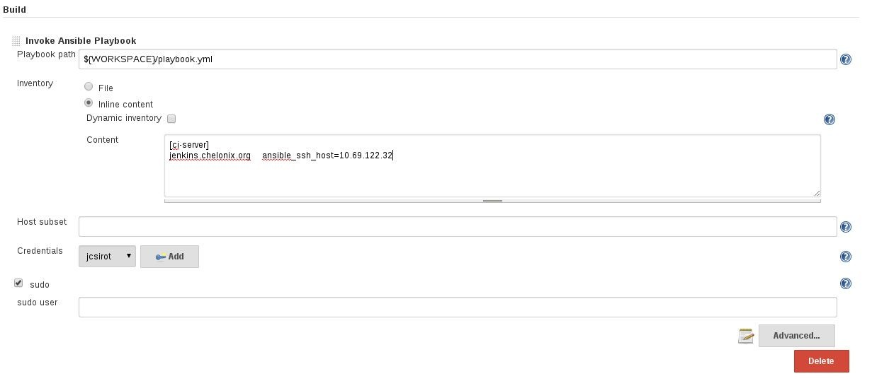
Jenkins Ansible Plugin
https://wiki.jenkins-ci.org/display/JENKINS/Ansible+Plugin

Slide 91
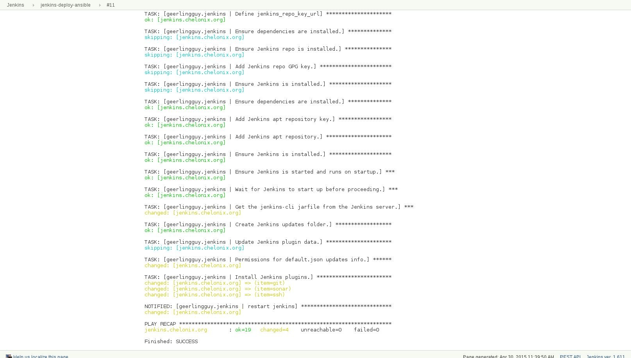
Jenkins Ansible Plugin

Slide 92
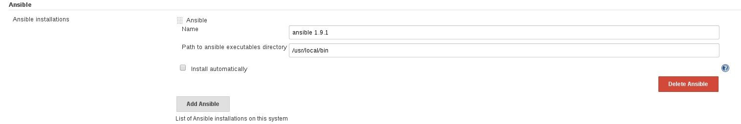
Jenkins Ansible Plugin

Slide 93
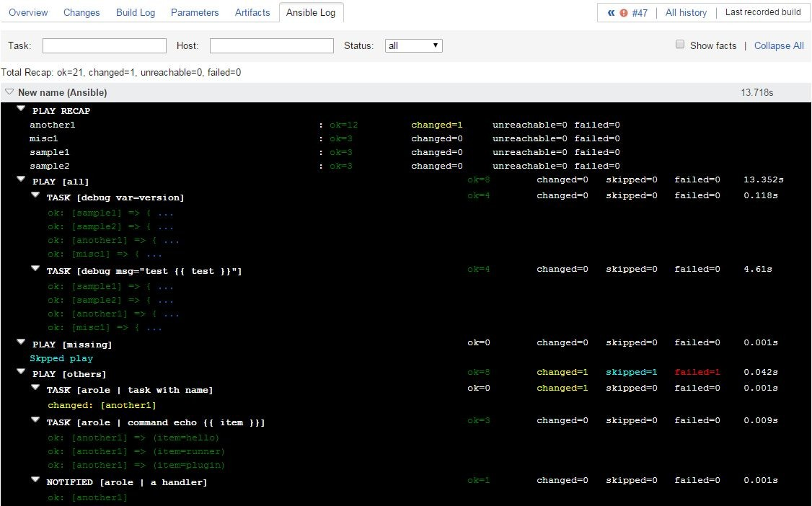
Teamcity Ansible Plugin
https://github.com/andreizhuk/tc-ansible-runner

Slide 94
Ansible for AWS

Slide 95
Boto
Boto is a Python package that provides interfaces to Amazon Web Services. Currently, all features work with Python 2.6 and
2.7. Ansible uses boto to communicate with AWS API.
It can be installed via OS package manager or pip.
$ apt-get install python-boto
$ pip install boto

Slide 96
Amazon EC2 Inventory Management
To get started with dynamic inventory management, you’ll need to grab the EC2.py script and the EC2.ini config file. The EC2.py script is written using the Boto EC2 library and will query AWS for your running Amazon EC2 instances.
$ wget https://raw.githubusercontent.com/ansible/ansible/devel/contrib/inventory/ec2.py
$ wget https://raw.githubusercontent.com/ansible/ansible/devel/contrib/inventory/ec2.ini

Slide 97
Amazon EC2 Inventory Management
$ export AWS_ACCESS_KEY_ID='YOUR_AWS_API_KEY'
$ export AWS_SECRET_ACCESS_KEY='YOUR_AWS_API_SECRET_KEY'
$ export ANSIBLE_HOSTS=/etc/ansible/ec2.py
$ export EC2_INI_PATH=/etc/ansible/ec2.ini
$ ssh-agent bash
$ ssh-add ~/.ssh/keypair.pem

Slide 98
Amazon EC2 Inventory Management
$ /etc/ansible/ec2.py --list
$ ansible -m ping tag_Ansible_Slave
10.1.2.137 | success >> { "changed": false, "ping": "pong"
}
10.1.2.136 | success >> { "changed": false, "ping": "pong"
}

Slide 99
Ansible Cloud Modules
From the beginning, Ansible has offered deep support for AWS. Ansible can be used to define, deploy, and manage a wide variety of AWS services. Even the most complicated of AWS environments can be easily described in Ansible playbooks.
http://docs.ansible.com/ansible/list_of_cloud_modules.html

Slide 100
Create Elastic Load Balancer
- name: Configure Load Balancer ec2_elb_lb:
name: y-lb-{{suffix}} state: present
region: "{{ec2_region}}" connection_draining_timeout: 60 cross_az_load_balancing: yes
security_group_ids: "{{lb_security_group.group_id}}" subnets: "{{subnet_az_a}},{{subnet_az_b}}" listeners:
- protocol: http load_balancer_port: 80
instance_port: 80

Slide 101
Configure Autoscaling Group
- name: Configure Autoscaling Group ec2_asg:
name: y_asg_{{suffix}} region: "{{ec2_region}}"
launch_config_name: "{{launch_config.name}}" load_balancers: "y-lb-{{suffix}}" availability_zones: "{{az_a}},{{az_b}}" health_check_period: 60
health_check_type: ELB replace_all_instances: yes min_size: "{{min_size}}"
max_size: "{{max_size}}" desired_capacity: "{{desired_capacity}}"
vpc_zone_identifier: "{{subnet_az_a}},{{subnet_az_b}}" wait_timeout: 600

Slide 102



Say Goodbye to "Works on my Machine" Bugs
Code
Test
Bakery
IMAGE

Slide 103
LAB #7
Deploy Greeting REST Service to AWS

Slide 104
Deploy Greeting REST Service to AWS
For instructions visit https://github.com/maaydin/ansible-tutorial/tree/master/lab-07 .
PLAY [localhost] ***************************************************************
TASK [setup] ******************************************************************* ok: [localhost]
TASK [ec2-auto-scale : Configure Launch Configuration Security Group] ********** ok: [localhost]
TASK [ec2-auto-scale : debug] ************************************************** ok: [localhost] => {
"msg": "Launch Configuration Security Group id=sg-961ee6f0"
}

Slide 105
Provisioning Docker Host

Slide 106
Installing Docker
To get the latest version of docker it is better (and easier) to install from the script provided by docker.
https://get.docker.com/
It is also required to install docker-py via pip to manage your containers from Ansible.

Slide 107
Docker & Ansible

Slide 108
Ansible Makes Docker Better
If you know docker-compose, you know Ansible (almost).
Because you need to configure the system that your containers are running on.
Because you want to call out to other systems to configure things.
Because you want to build testing directly into your container deployment process.

Slide 109
Ansible Docker Modules
docker_container - manage docker containers
docker_image - Manage docker images.
docker_image_facts - Inspect docker images
docker_login - Log into a Docker registry.
docker_network - Manage Docker networks
docker_service - Manage docker services and containers.

Slide 110
Creating a Container
With docker_container module you can manage your docker containers.
---
- name: Create a redis container docker_container:
name: myredis image: redis state: present

Slide 111
LAB #8
Install Docker & Create a Container

Slide 112
Install Docker on Ansible Controller
---
name: Download Installation Script get_url:
url: https://get.docker.com/ dest: /tmp/docker.sh
name: Install docker shell: sh /tmp/docker.sh args:
creates: /usr/bin/docker

Slide 113
Create a Redis Container
---
- name: Create a redis container docker_container:
name: myredis image: redis
command: redis-server --appendonly yes state: present
exposed_ports:
- 6379

Slide 114
Have Fun with

